Slide 1
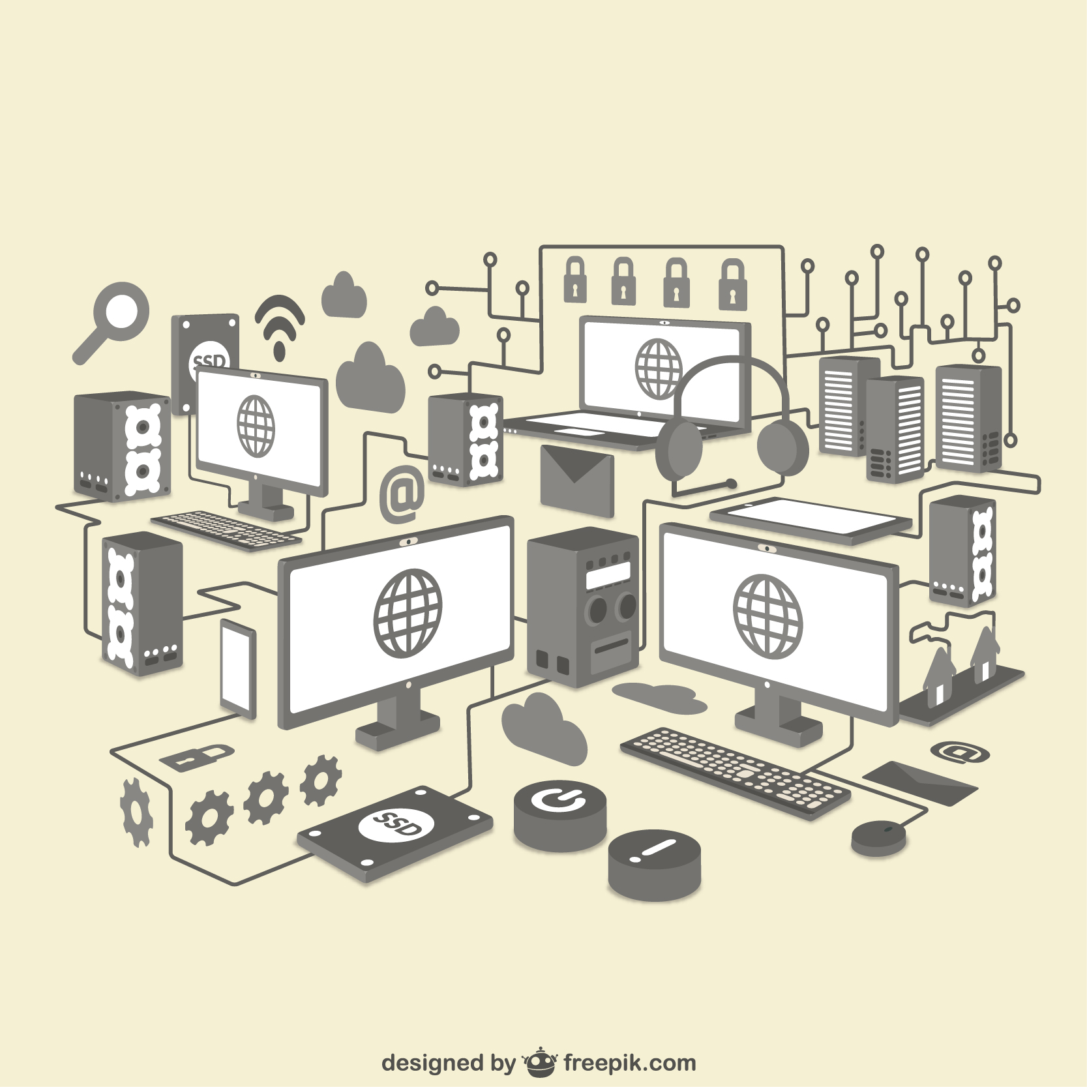
The Art OF Microservices: Introducing Distributed Systems

Slide 2
Monolithic vs. Microservices Architecture

Slide 3
What is Microservices Architecture?
Microservices, or microservices architecture, is a cloud-native architectural approach in which a single application is composed of many loosely coupled and independently deployable smaller components or services.
Microservices are a popular architectural style for building applications that are resilient, highly scalable, independently deployable, and able to evolve quickly. Building a successful microservices architecture requires a fundamental shift in mindset. It goes beyond decomposing an application into smaller services. You must also rethink how systems are designed, deployed, and operated.
Microservices architecture (often shortened to microservices) refers to an architectural style for developing applications. Microservices allow a large application to be separated into smaller independent parts, with each part having its own realm of responsibility. To serve a single user request, a microservices-based application can call on many internal microservices to compose its response.
A microservices architecture is a type of application architecture where the application is developed as a collection of services. It provides the framework to develop, deploy, and maintain microservices architecture diagrams and services independently.

Slide 4
What is Microservices Architecture?
Microservices typically:
Have their own technology stack, inclusive of the database and data management model.
Communicate with one another over a combination of representational state transfer (REST) APIs, event streaming and message brokers.
Are organized by business capability, with the line separating services often referred to as a bounded context.

Slide 5
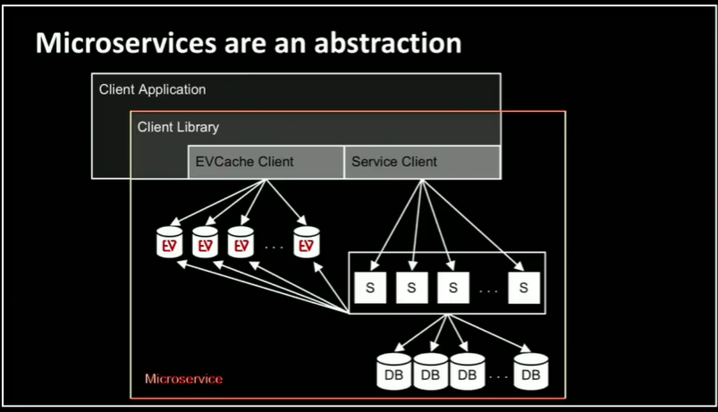
The microservice architectural style is an approach to developing a single application as a suite of small services, each running in its own process and communicating with lightweight mechanisms, often an HTTP resource API.

Slide 6
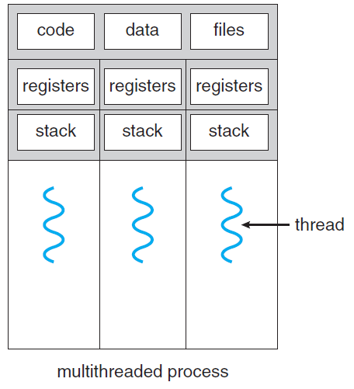
The idea of API Gateway:
Service
Service
Now we have these processes running simultaneously; in other words, the processes are parallel
Since we have running instances, we need communication, so we need something shared at this time; it will be the network, not RAM
Two main parts will guide our design: the HTTP request and how the data transfers through the network (JSON)
Since our apps communicate through the network, we are doing network/web programming.
Now we need an API Gateway, which is a software layer that presents a single entry point for clients (such as web or mobile applications) to access multiple backend services, while simultaneously managing client/server interactions.
Service
Service

Slide 7
The idea of API Gateway:
Service
Service
Service
Service
Service
Service
Service
Service
Service
Service
API Gateway

Slide 8
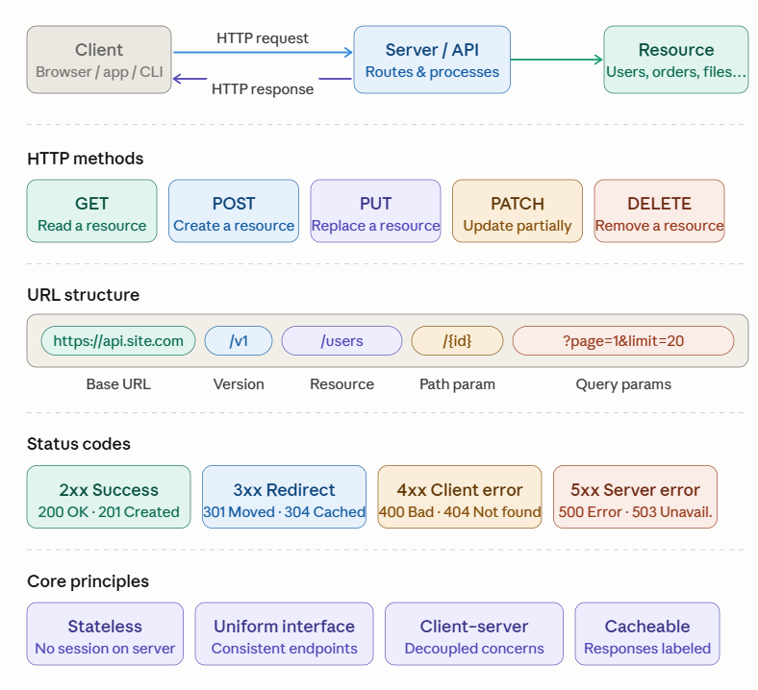
The REST API:

Slide 9
Distributed Databases Concepts

Slide 10
Inro:
Distributed databases bring the advantages of distributed computing to the database domain
A distributed computing system consists of several processing sites or nodes that are interconnected by a computer network and that cooperate in performing certain assigned tasks
As a general goal, distributed computing systems partition a big, unmanageable problem into smaller pieces and solve it efficiently in a coordinated manner.
The origins of big data technologies come from distributed systems and database systems, as well as data mining and machine learning algorithms that can process these vast amounts of data to extract needed knowledge.
A distributed database (DDB) is a collection of multiple logically interrelated databases distributed over a computer network. With the following conditions:
Connection of database nodes over a computer network.
Logical interrelation of the connected databases.
Possible absence of homogeneity among connected nodes.

Slide 11
Transparency:
The concept of transparency extends the general idea of hiding implementation details from end users
A highly transparent system offers a lot of flexibility to the end user/application developer since it requires little or no awareness of underlying details on their part
Data organization transparency (also known as distribution or network transparency).
Location transparency.
Replication transparency.
Fragmentation transparency:
Horizontal fragmentation/Sharding distributes a relation (table) into sub-relations that are subsets of the tuples (rows) in the original relation.
Vertical fragmentation distributes a relation into sub-relations where each sub-relation is defined by a subset of the columns of the original relation.

Slide 12
Scalability & Autonomy:
Scalability refers to the system's ability to expand its capacity without interruption while continuing to operate.
Horizontal scalability: This refers to expanding the number of nodes in the distributed system.
Vertical scalability: This refers to expanding the capacity of the individual nodes in the system
Autonomy determines the extent to which individual nodes or DBs in a connected DDB can operate independently. A high degree of autonomy is desirable for increased flexibility and customized maintenance of an individual node.

Slide 13
CAP Theorem:
We assumed that the distributed database system (DDBS) is required to enforce the ACID properties (atomicity, consistency, isolation, durability) of transactions that are running concurrently
In the field of distributed systems, there are various levels of consistency among replicated data items, from weak consistency to strong consistency
The CAP theorem, which was originally introduced as the CAP principle, can be used to explain some of the competing requirements in a distributed system with replication. The three letters in CAP refer to three desirable properties of distributed systems with replicated data: consistency (among replicated copies), availability (of the system for read and write operations), and partition tolerance (in the face of the nodes in the system being partitioned by a network fault).
The CAP theorem states that it is not possible to guarantee all three of the desirable properties—consistency, availability, and partition tolerance—at the same time in a distributed system with data replication. If this is the case, then the distributed system designer would have to choose two properties out of the three to guarantee.

Slide 14
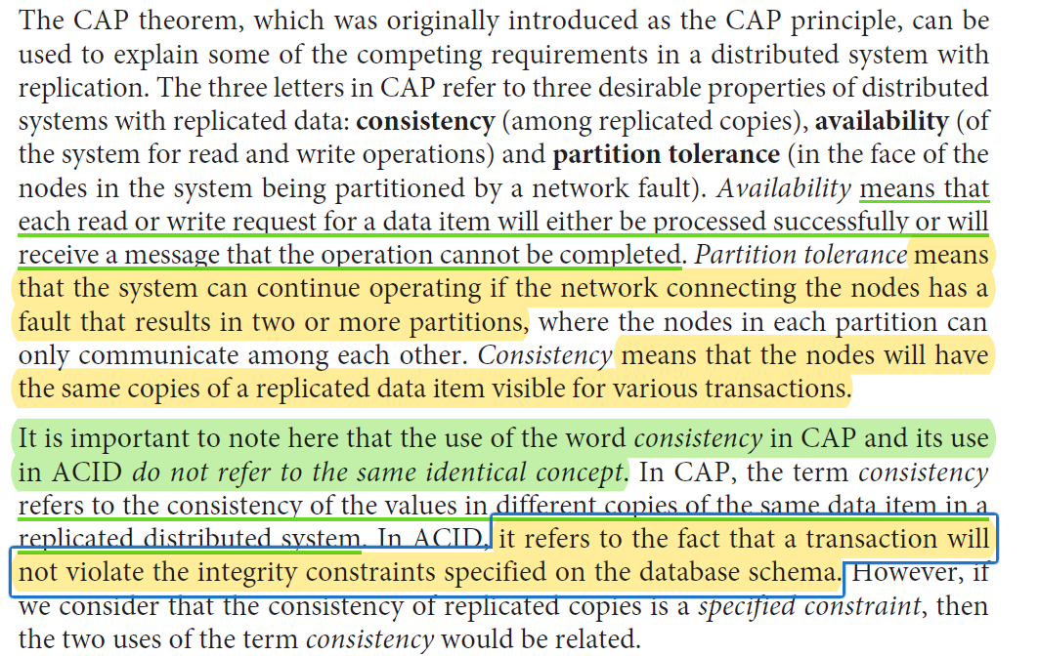
CAP Theorem:

Slide 15
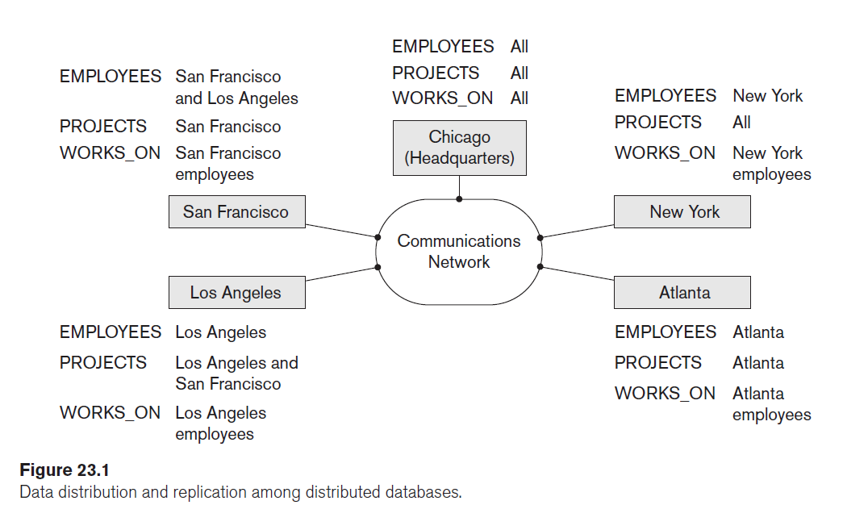

Slide 16
Distributed Computing Models

Slide 17
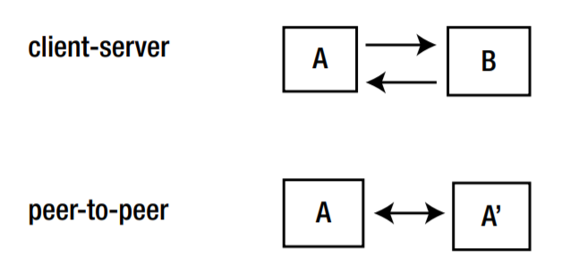
Distributed Computing Models:
If both components are equivalent, they are both able to initiate and respond to messages, then we have a peer-to-peer system. Note that this is a logical classification: one peer may be a 16,000-core supercomputer, the other might be a mobile phone. But if both can act similarly, then they are peers.

Slide 18
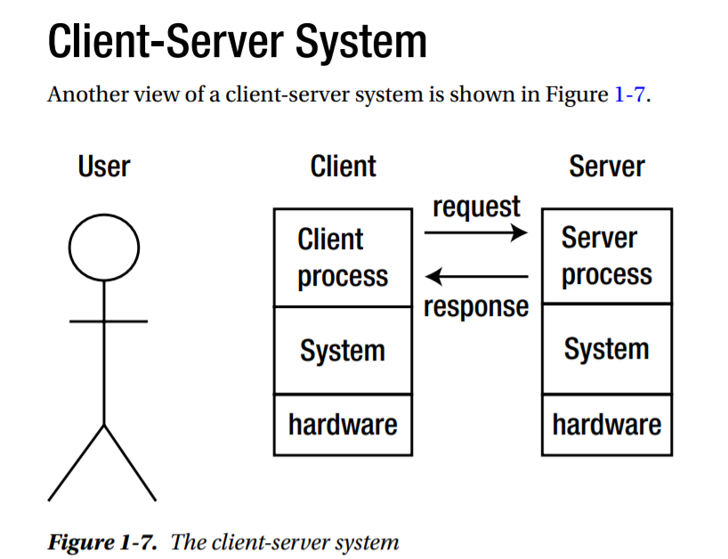

Slide 19
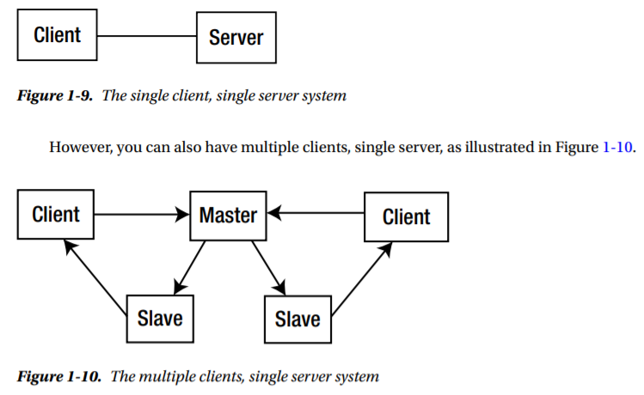
Server Distribution:

Slide 20
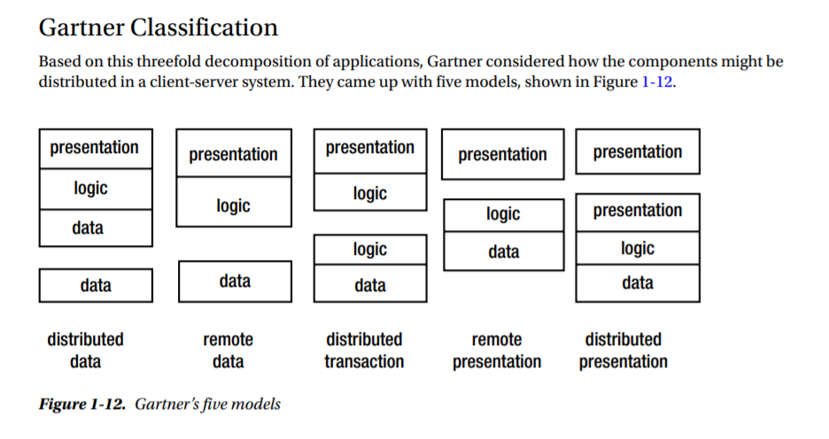

Slide 21
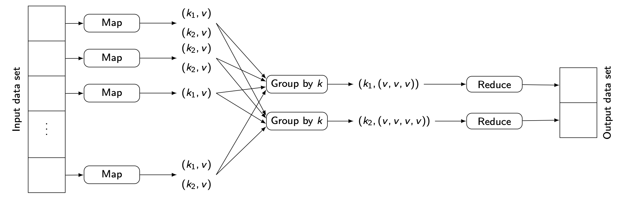
MapReduce Processing

Slide 22
System Workflow:
1- SIMD or SDMI
2- Source of the data
3- The task
4- The command to run
A system with a friendly UI
Reducer

Slide 23
THANK YOU

